Slide 1
ASEAN – QA Forum: Networking for Building & Sustaining Quality Culture in HEIs
7th-8th November 2019
Foreign Trade University, Hanoi, Vietnam

Slide 2
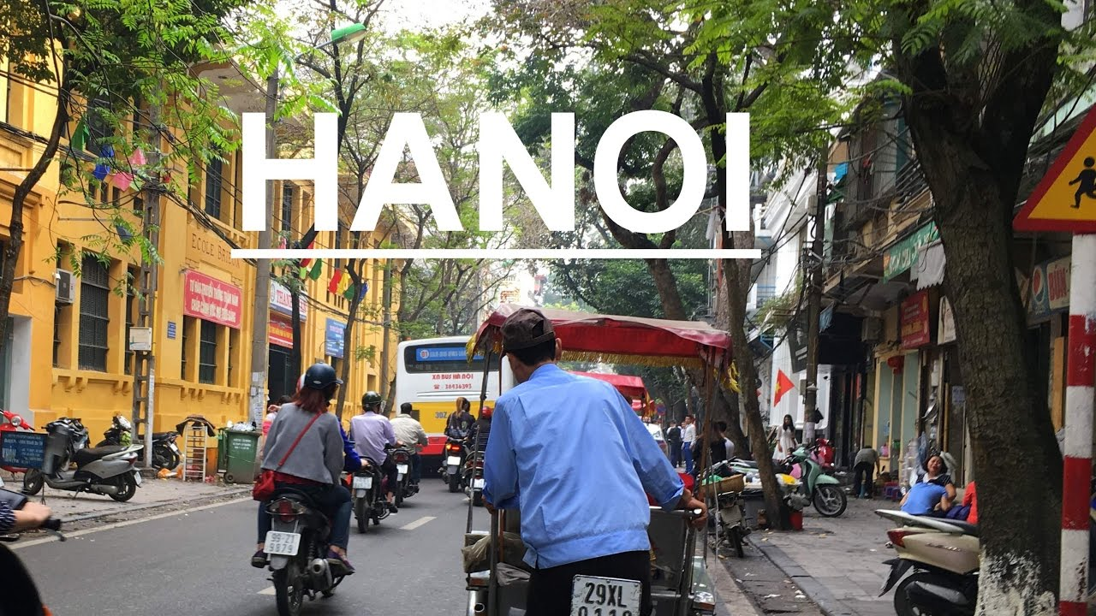
ASEAN QA Forum
Association Building
Project Book
Idea Initiation
ASEAN QA Forum
* Association
Building (General
Assembly)
* Seminar
* Workshop
* Strategic Planning
ASEAN QA Forum
. Association Building
. Project Book
Background
ASEAN QA Forum
Association Building
Project Book
31/07 -02 / 08 / 2019
25-27 / 01 / 2019
31 / 08 / 2018
ASEAN QA Forum
Association Building
Project Book
25-27 / 04 / 2019
06-08 / 11 / 2019
23 / 03 / 2018

Slide 3
Vision
“The ASEAN Quality Assurance Association shall be a Regional Network Sharing Expertise and Resources for Enhancing Quality in ASEAN Higher Education Institutions”

Slide 4
Mission
The ASEAN QAA is committed to promote quality assurance in higher education institutions (HEIs) in the region through:
capacity-building programs in collaboration with other quality
assurance networks in South East Asia and beyond;
the provision of professional and technical assistance to its institutional and individual members in the area of quality
assurance; and,
dissemination and sharing of best practices in quality
assurance among HEIs in the region and beyond through
publications (online and print) and use of database on QA.

Slide 5
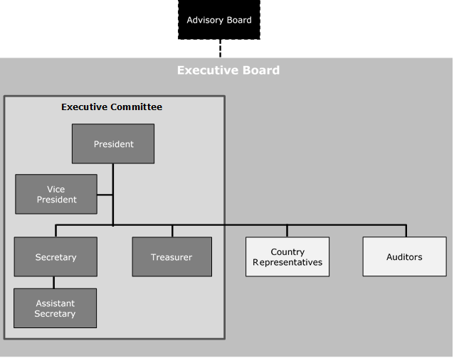
Executive Board & Executive Committee

Slide 6
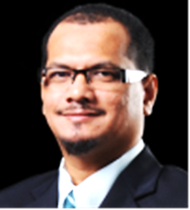
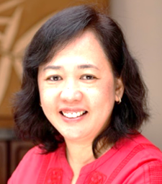
MALAYSIA
Executive Board & Executive Committee
PRESIDENT
VICE PRESIDENT
JAMALUDDIN IBRAHIM
Universiti Teknologi PETRONAS
ALYSSA PELEO-ALAMPAY
University of the Philippines
PHILIPPINES

Slide 7
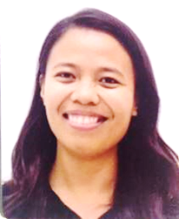
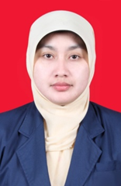
Executive Board & Executive Committee
SECRETARY
ASSISTANT SECRETARY
IRISH TEJERO – DAKAY
University of San Carlos
MARIA HIDAYATI
Universitas Negeri Malang
PHILIPPINES
INDONESIA

Slide 8
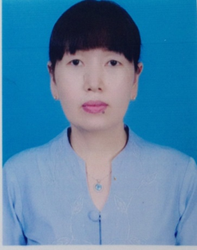
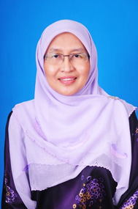
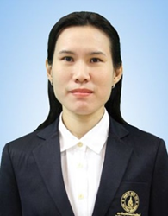
MYANMAR
Executive Board & Executive Committee
TREASURER
AUDITOR
AUDITOR
THIRI AUNG
Dawei University
ROHAIDA MOHD SAAT
University of Malaya
THASANEEYA RATANAROUTAI NOPPARATJAMJOMRAS
Mahidol University
MALAYSIA
THAILAND

Slide 9
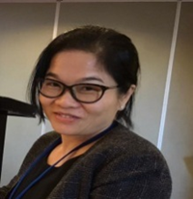
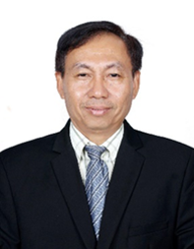
Executive Board & Executive Committee –Country Representative
CAMBODIA
KY RAVIKUN
Phnom Penh International University (PPIU) Relations
VONG CHORVY
Royal University of Phnom Penh

Slide 10
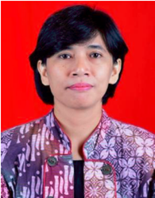
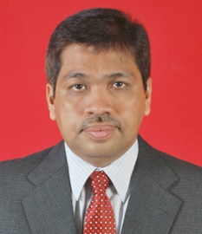
Executive Board & Executive Committee –Country Representative
INDONESIA
MARIA MAGDALENA
WAHYUNI INDERAWATI
Atma Jaya Catholic
SYAHRUN NUR MADJID
Universitas Syiah Kuala

Slide 11
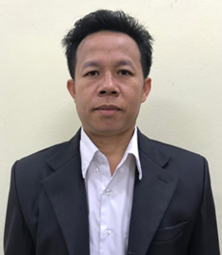
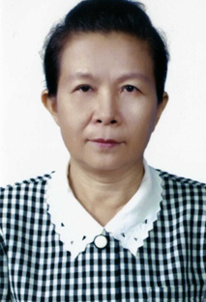
LAOS
Executive Board & Executive Committee –Country Representative
THANONGSACK DUANGDALA
National University of Laos
PHOUMINDR BOUATHEP
Department of Health Care & Rehabilitation Ministry of Health, Lao PDR

Slide 12
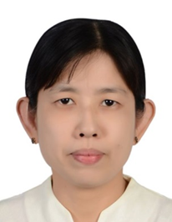
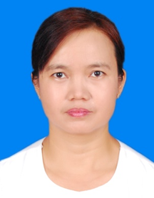
MYANMAR
Executive Board & Executive Committee –Country Representative
NILAR TOE
Myanmar Maritime University
THWE THWE OO
Technological University (Hmawbi)

Slide 13
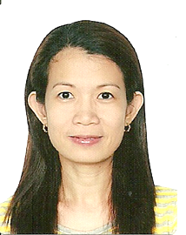
Executive Board & Executive Committee –Country Representative
PHILIPPINES
LUCILA CALAIRO
De La Salle University Dasmarinas

Slide 14
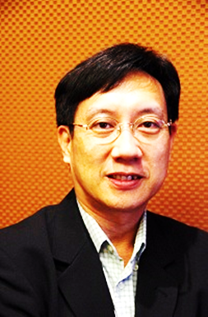
THAILAND
Executive Board & Executive Committee –Country Representative
CHAILERD PICHITPORNCHAI
Mahidol University

Slide 15
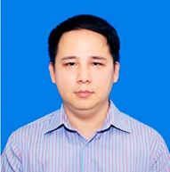
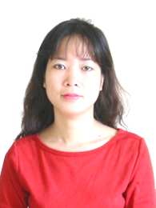
VIETNAM
Executive Board & Executive Committee –Country Representative
VO SY MANH
Foreign Trade University
ASSOC. PROF. HOANG DAO BAO TRAM
University of Medicine and Pharmacy
Ho Chi Minh City

Slide 16
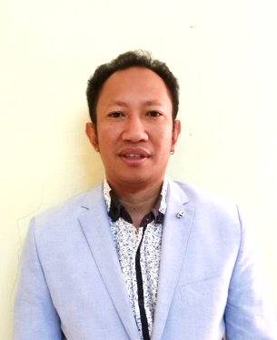
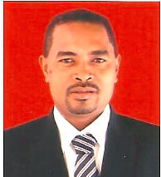
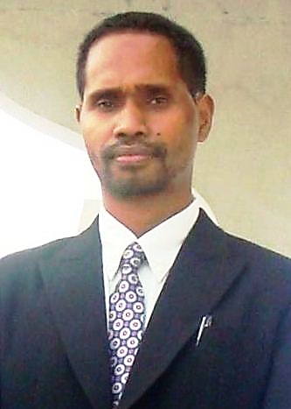
TIMOR LESTE
Executive Board & Executive Committee
– Country Representative
PEDRO BARRETO XIMENES
Accreditation Standards(ANAAA)
Institute of Business (IOB)
APOLINARIO MARCAL
MAIA DO REGO
Universidade da Paz
MARLIM DA SILVA
Institute of Business (IOB)

Slide 17
Type of Membership
ARTICLE IV
Membership
Section 1. Individual Membership
Individual membership of the association is open to experts and practitioners involved in the development of quality assurance in academic institutions in South East Asia including Timor Leste.
Section 2. Institutional Membership
The academic institution of the registered individual member may apply for the institutional membership of the Association.

Slide 18
Type of Membership
ARTICLE IV
Membership
Section 3. Honorary Membership
The highest officer in charge of Quality Assurance in the member institution (e.g. Vice President/Deputy Vice Chancellor/Vice Rector) shall be automatically entitled for Honorary Membership.
Only individual members are eligible to participate in the governance and administration of the Association.
All applicants shall submit a duly completed application form to the association.

Slide 19
Rights & Obligations
ARTICLE IV
Membership
Section 5. Rights and Obligations
The members of ASEAN-QAA shall have the following rights and obligations:
Participate in and support the activities of the ASEAN-QAA;
Abide by the rules, policies, and regulations formulated by the Executive Committee;
Attend all the meetings called by the Executive Committee;
Cast one (1) vote per member in the election of the members of the Executive Committee and the Executive Board;
Hold an Executive Committee position and/or be an Executive Board Member provided he/she is elected;
Hold a position as the Country Representative provided he/she is elected;
Discuss any question or matter regarding the present Constitution and By-Laws of the ASEAN-QAA;

Slide 20
Rights & Obligations
ARTICLE IV
Membership
Section 5. Rights and Obligations
8. Have access and right to reproduce any relevant documents pertaining to the
ASEAN-QAA, such as this Constitution and By-Laws, among others;
9. Receive Certificate of Membership;
10. Have access to Quality Assurance experts, QA-based resources/ publications by
the association;
11. Optimize opportunities for collaboration and networking;
12. Receive priority service (Priority-Lane) for any Programme organized by the
Association;
13. Receive discount for relevant programmes organized by the association
(if available and applicable);
14. Exercise such other rights and obligations as may be deemed necessary by the
Executive Committee;

Slide 21
Membership Fees
ARTICLE IV
Membership
Section 6. Membership Fees
Type of Membership | Application Fee | Annual Fee | Lifetime Membership Fee
Individual | Not Applicable | 25.00 | 100.00
Institutional | Not Applicable | 100.00 | 300.00

